Slide 1
CS492 PROJECT
PROJECT PRESENTATION
GROUP MEMBERS
ADAM BASIL ANIL - 8
ASWIN TOMY - 50
ATHUL MURALI - 51
AVINASH HARESH - 54
GUIDED BY
MR. AJITH S

Slide 2
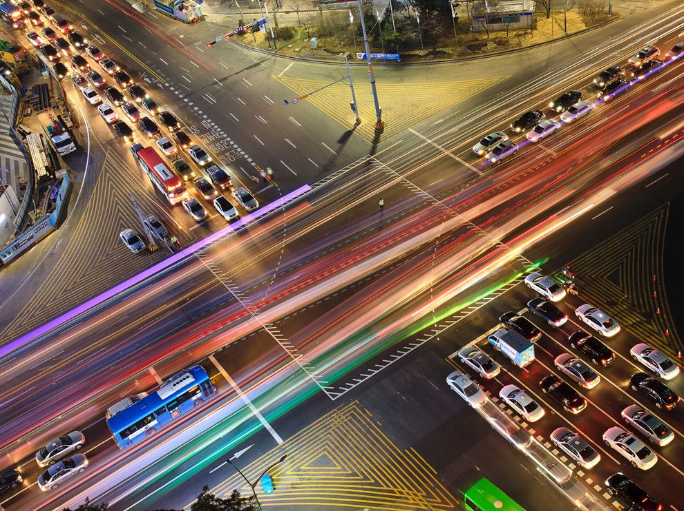
TRAFFIC OPTIMIZATION
PROJECT TITLE:

Slide 3
Contents
Problem Statement
Solution
Scope & Objectives
Assumption & Constraints
Hardware and Software Requirements
Literature Survey
Project Overview
Creation of background and objects
Modular Division
Random Generation of Vehicles
Random Turning of Vehicles
Vehicle Counting and Implementation
Dynamic Change of Signals
Results
Conclusion
Project Demo

Slide 4
PROBLEM STATEMENT
The present-day traffic signal control only works on a fixed time delay basis irrespective of the vehicle density.
Traffic jams not only cause extra delay and stress for the drivers, but also increase fuel consumption, add transportation costs, and increase air pollution.
Traffic lights needs an improvement over the present static timed method where the number of queued vehicles at each direction is not considered.

Slide 5
Conventional Systems
Manual Controlling: As the name suggests, it requires manpower to control the traffic. The traffic police are allotted for a required area to control traffic. The traffic police carry signboard, sign light and whistle to control the traffic.
Automatic Controlling: Automatic traffic signals are controlled by timers and electrical sensors in traffic light, a constant numerical value is loaded in timer. The lights automatically getting ON and OFF based on timer value.
Electronic Sensors: Another advanced method is placing some loop detectors or proximity sensors on the road. The sensors gives data about the traffic on the road. According to the sensor data, the traffic signals are controlled.

Slide 6
SOLUTION
When the timers of these traffic signals are set according to vehicle density in each direction, the system becomes adaptive.
-Takes the vehicle count at each side.
-Increase the green signal time for sides having more vehicle density.
-Preset a maximum and minimum Green Time to avoid starvation of a lane.
Advantages
-It reduces the idle time being wasted at the junction.
-It reduces the traffic congestion.
-No need of manpower.
-Decreases fuel consumption.

Slide 7
SCOPE & OBJECTIVES
PROJECT SCOPE
Proposed system can be used for the development of current traffic control system.
Reduction in pollution rate caused by traffic congestion.
Decrease in the consumption of fuel by automobiles.
OBJECTIVES
To make a simulation to show the efficiency of the dynamic traffic timer system.
To reduce traffic congestion at the junction.
To decrease the fuel consumption of vehicles waiting at junction.

Slide 8
ASSUMPTIONS & CONSTRAINTS
ASSUMPTIONS:
There is a highway on one side of the road and a local city road in the other side.
Right turning vehicles are less common compared to straight-going vehicles.
Traffic rules are followed by all vehicles.
CONSTRAINTS:
Only works on 4-way intersections.

Slide 9


HARDWARE & SOFTWARE REQUIREMENTS
HARDWARE REQUIREMENTS
A Local PC with basic configuration and storage.
SOFTWARE REQUIREMENTS
Packages: Pygame
Visual Studio Code

Slide 10
LITERATURE SURVEY
PAPER NAME | AUTHOR | ADVANTAGE
Smart Control of Traffic Light Using Artificial Intelligence | Mihir M. Gandhi, Devansh S. Solanki, Rutwij S. Daptardar, Nirmala Shinde Baloorkar | Switching the traffic lights based on the vehicle density to reduce congestion
Smart Traffic Control System Using Image Processing | Vismay Pandit , Jinesh Doshi, Dhruv Mehta , Ashay Mhatre and Abhilash Janardhan | Edge detection has been carried out using Prewitt edge detection operator and according to percentage of matching traffic light durations can be controlled.

Slide 11
PROJECT OVERVIEW
In this project, a simulation is created from scratch using Pygame to replicate the movement of vehicles across a traffic intersection.
It is a 4-way intersection with traffic signals in each direction.
A second simulation window was created to compare the efficiency of our dynamic traffic system over current traffic system.
The simulation has two outputs. (Simulation time & Number of vehicles passed)

Slide 12
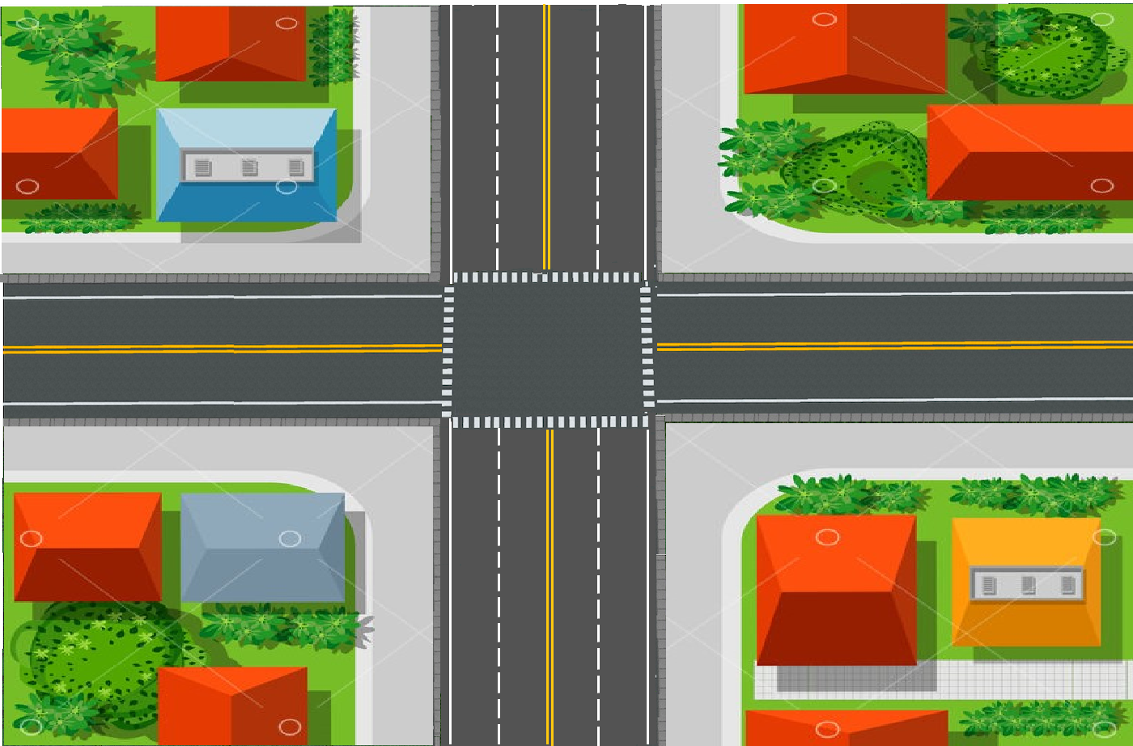



Creation of background and objects
car.png
truck.png
mod_int.png
bus.png

Slide 13




Creation of background and objects
Initializing objects
green.png
green2.png
Displaying objects
red.png
yellow.png

Slide 14


MODULAR DIVISION
MODULE 1
Random vehicle generation
MODULE 2
Smooth and random turning of vehicles
MODULE 3
Vehicle counting and Implementation
MODULE 4
Dynamic signal change algorithm

Slide 15
Random vehicle generation
VehicleGenerate() function is used to generate vehicles.
Vehicle type and lane number is randomized using a random function to make the simulation more realistic.
Vehicle Type [car,bus,truck].
A new vehicle is added to the simulation after every one second.

Slide 16
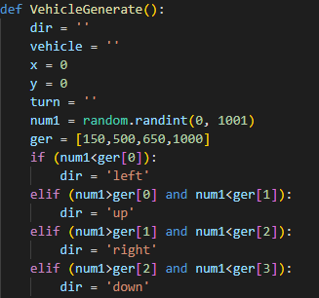
Random vehicle generation

Slide 17
Smooth and Random turning of vehicles
In this module, we added the ability of vehicles to turn to either left or right.
This was performed using 3 different objects (images) of vehicles to show the turning.
It is done to avoid the blurring of vehicles.
Objects are running in a loop in 3 directions:
30 degree
60 degree
90 degree

Slide 18
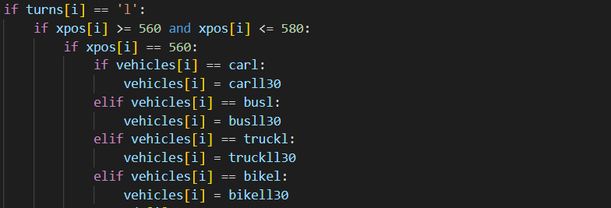






Smooth and random turning of vehicles
car.png
carl30.png
carl60.png
carl90.png
truck.png
truckr30.png
truckr60.png
truckr90.png

Slide 19
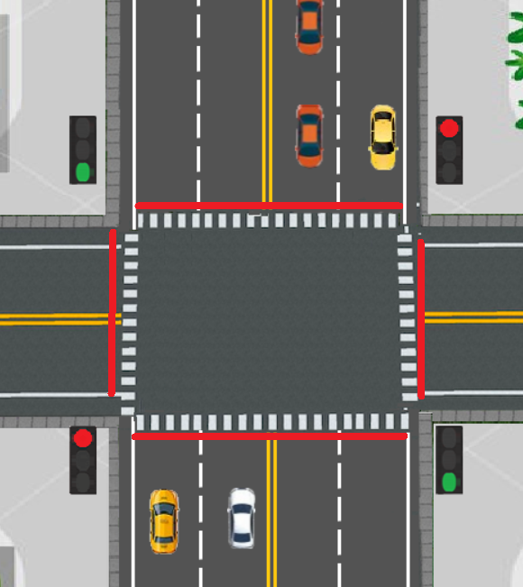
Vehicle Counting
Vehicles passing through those coordinates (marked as red) will be counted as passed.
Random vehicles which enters into the screen will be considered for counting at each side.
This vehicle count will be the factor for the equation of green signal time.

Slide 20
Algorithm Implementation
Green Signal Time = 2* (vehiclelcount + vehiclercount) +1
OR
Green Signal Time = 2* (vehicleucount + vehicledcount) +1
where,
vehiclelcount = vehicle count at left direction
vehiclercount = vehicle count at right direction
vehicleucount = vehicle count at up direction
vehicledcount = vehicle count at down direction

Slide 21
Dynamic change of signals
‘counter’ is the variable used for the green signal time.
If the next green signal is for up and down direction, counter is set as
2* (vehicleucount + vehicledcount) +1.
If the next green signal is for left and right direction, counter is set as
2* (vehiclelcount + vehiclercount) +1.
Maximum green signal time is set as 40 seconds.
Minimum green signal time is set as 10 seconds.
20% of counter value is given for right turn.
If the counter value exceeds the maximum time, counter is set as 40.
If the counter value is less than the minimum time, counter is set as 10.

Slide 22

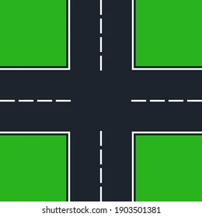


Order of signal change

Slide 23


RESULTS
There are two outputs for this simulation:
Simulation Time
Number of vehicles passed
We compare the number of vehicles passed in the current traffic system and dynamic traffic system at a constant time inorder to check the efficiency of the new system.

Slide 24
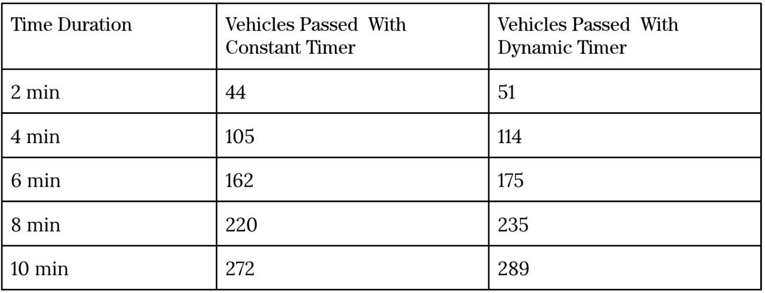
RESULTS

Slide 25
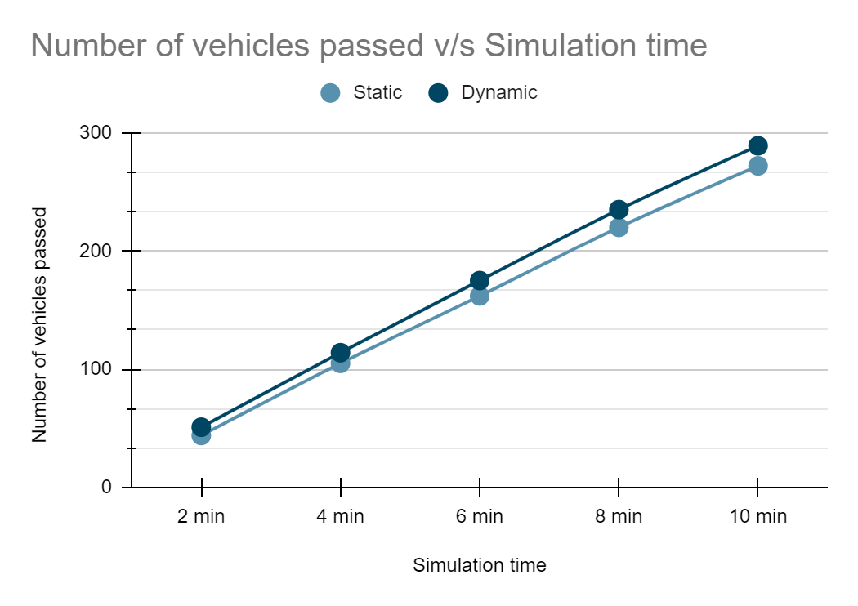
RESULTS

Slide 26
CONCLUSION
It is clear that the proposed system sets the green time adaptively according to the traffic density at the junction, giving more green time duration for sides having more vehicle density.
The graph shows that the dynamic system is more efficient than the current traffic system. When the simulation time increases, efficiency also increases. It reduces the waiting time of vehicles at the junction. This in turn reduces pollution and decreases fuel consumption.

Slide 27
PROJECT DEMO

Slide 28
THANK YOU

